Slide 1
Project Title: Op-Amp Project
Name: Jacob Vaught
USC ID: Y10786492
Email: jvaught@sc.edu

Slide 2
Project Objective
This project has 3 main goals:
It aims to determine how op-amps react to different inputs to a pulse wave.
It attempts to accurately use LT-Spice and MATLAB to simulate the given op-amp circuit
It attempts to demonstrate the differences between LT-Spice(realistic) and MATLAB (ideal/theoretical) results are demonstrated quite dramatically in this project

Slide 3
Project Technology
Although technology used was already mentioned, it is a rubric item, and is thus included here again.
MATLAB R2021B, student version
LT-SPICE XVII
Windows 10 PC with AMD Ryzen 5 processor w/ integrated graphics.

Slide 4
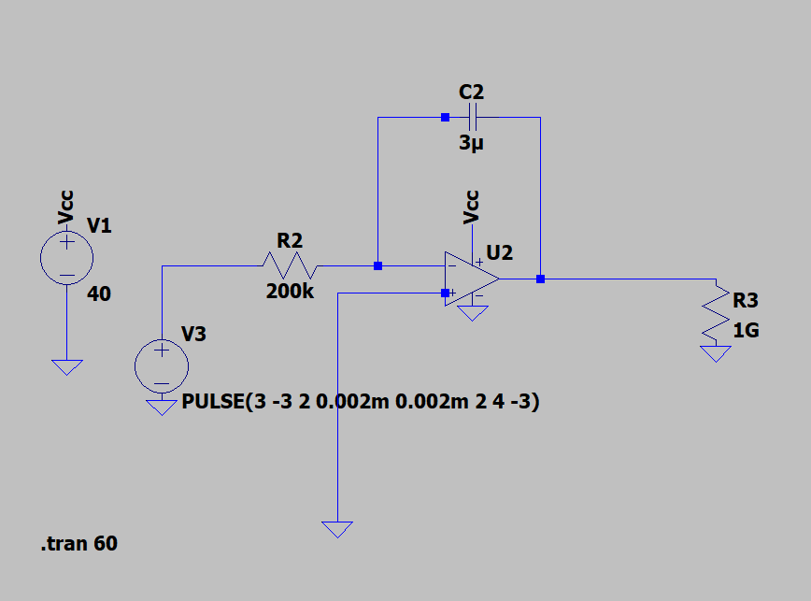
LT-Spice Circuit

Slide 5
LT-Spice background
The LT-SPICE portion, although simple, was complicated enough that a section dedicated to explanations was added.
A simple “ideal” op amp was first used, however, LT-SPICE kept throwing an error, so a “universal op-amp 2” was used. This was modeled after realistic op-amps, thus is NOT ideal
A Vcc of 15 volts was needed, but in most schematic images, a Vcc of 40V was used, however, actual files will show a Vcc of 15.
A R value of 200k was chosen since the lectures used a 200k resistor, and the C value was changed to match it.

Slide 6
LT-Spice Background cont.
The document requested that a PWL power source be used, but A PULSE power source was much simpler to implement and had the same results, thus was implemented.
After running a few times, it was noticed that the peak voltage increased after multiple cycles had been run, thus, the total runtime was increased from 4 second to 60 seconds to get a full scale of what was happening within the system.
A red line was drawn across each figure to illustrate the change in peak voltage over time.

Slide 7
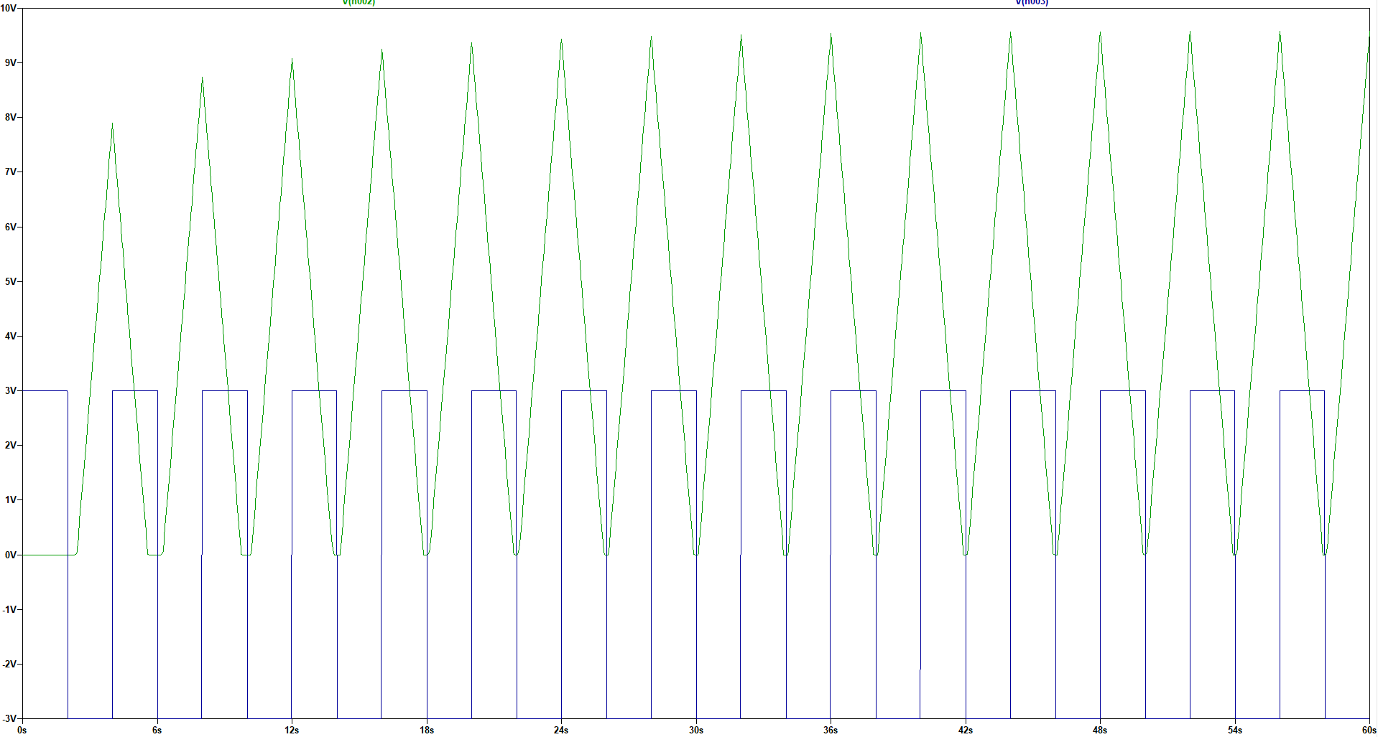
Results for 10 V from LT-Spice

Slide 8
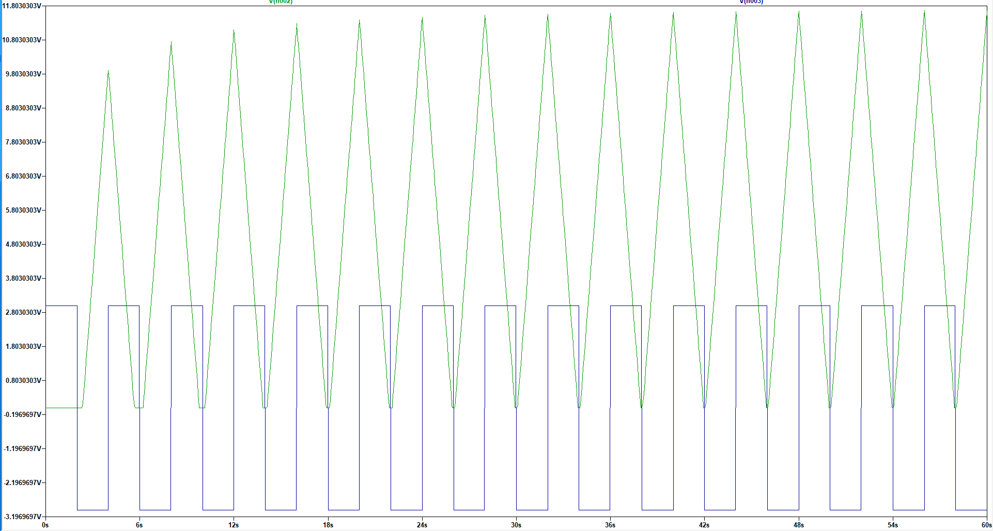
Results for 12 V from LT-Spice

Slide 9
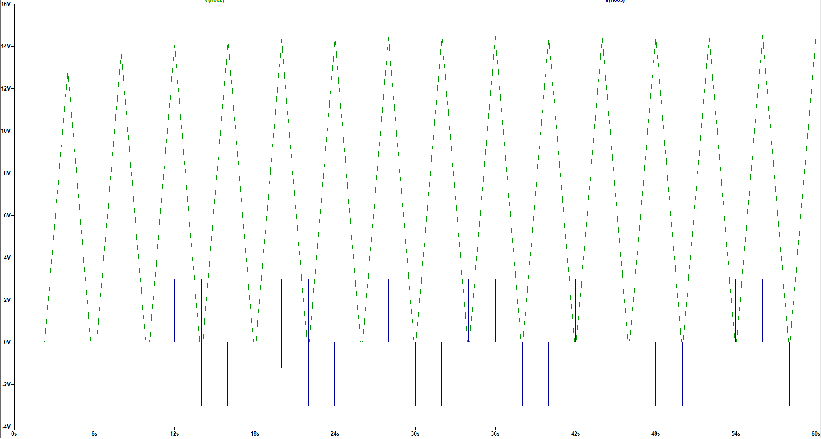
Results for 15 V from LT-Spice

Slide 10
MATLAB Background
The ustep() function was used to simplify the MATLAB code.
The MATLAB code just models a simple, ideal OP-AMP and shows both the input and output voltage waveforms.
The desired output voltage is set, and the input voltage is set, then the RC value is calculated.

Slide 11
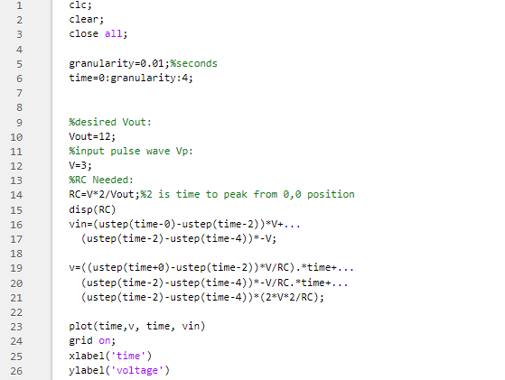
MATLAB Code

Slide 12
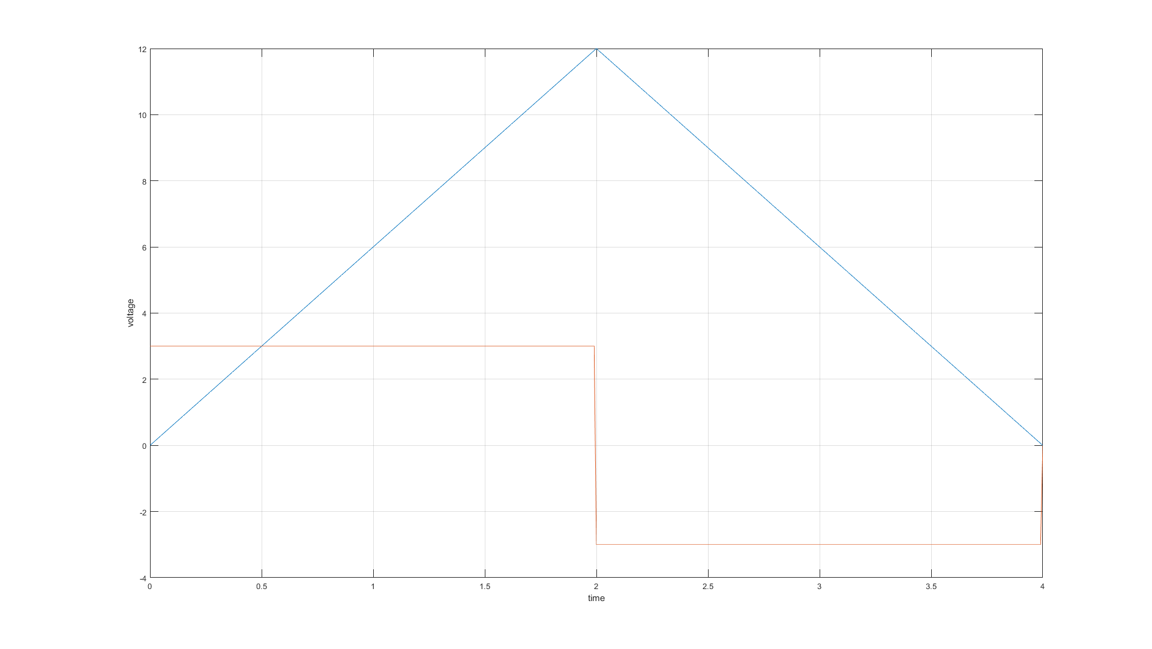
MATLAB Simulation for 12V

Slide 13

Discussion
The RC values are calculated via the following equations:
$$−\frac{1}{RC}=−\frac{1}{RC}=x s^{−1}$$
For $0≤t≤2$
$$v_{out}\left(t\right)=−\frac{1}{RC}\int_{0}^{t}{3}dt→v_{out}\left(t\right)=−\frac{3t}{RC}$$
For $2≤t≤4$
$$v_{out}\left(t\right)=−\frac{1}{RC}\int_{2}^{t}{3}dt+\left(−V_{out}(0)\right)→−\frac{1}{RC}\left(6t−2∗V_{out}(0)\right)$$

Slide 14
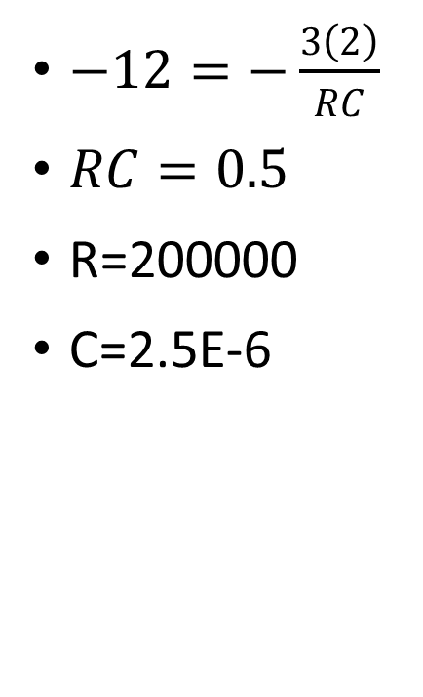
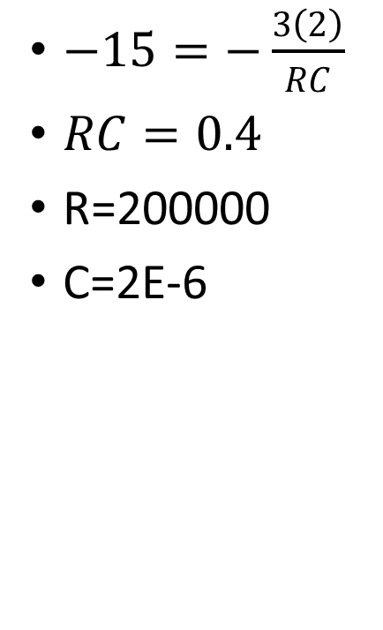
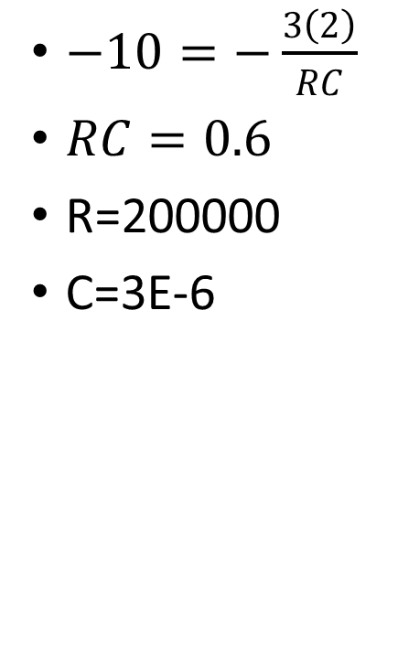
Discussion Cont.
$−12=−\frac{3\left(2\right)}{RC}$
$RC=0.5$
R=200000
C=2.5E-6
$−15=−\frac{3\left(2\right)}{RC}$
$RC=0.4$
R=200000
C=2E-6
$−10=−\frac{3\left(2\right)}{RC}$
$RC=0.6$
R=200000
C=3E-6

Slide 15
Discussions
The results show that the MATLAB OP-AMP voltage is quite ideal, exactly equal to the desired output voltage, however, the more realistic simulation, LT-SPICE, showed that the output voltage was generally within 0.5 V of the desired voltage and the peak voltages had a logarithmic shape
One thing of note is that the voltage is reversed for the MATLAB and the LT-Spice simulations.
I believe the accuracy is accurate, as a real op-amp takes time to charge with electrons before operating at full capacity. This is something many students learn in ELCT-363, Micro-electronics.

Slide 16
Conclusions
It can be concluded that LT-Spice is a more accurate simulation software for actual systems, and that it should be used more than MATLAB.
One thing of interest to Me is the fact that the output is the integral of the input to the system, which I had never known was possible with a simple op-amp.
Overall, the system seems to accurately compute the integral of an input.

Slide 17
References
Dr. Chen’s Op-amp lecture
Google
MathWorks website
LT-spice guides on google

